Slide 1

Dr. D.Y.PATIL SCHOOL OF ENGINEERING, PUNE
DEPARTMENT OF COMPUTER ENGINEERING
Blood Donation Website - Hope
PRESENTED BY:
Nutan Arya
Harsh Naikwade
Yukta Lokwani
Apeksha Meharkar
Mehlam Ali
UNDER THE GUIDANCE OF:
Prof. Ajita Mahapadi

Slide 2
INDEX
Introduction
Literature Survey
Problem Statement
Objectives & Scope
System Architecture
Advantages and Disadvantages
Application
Conclusion
References

Slide 3
Introduction
A human blood transfusion is a procedure of supplying a human body with adequate blood when needed as in cases of illness, accidents, diseases, surgery, etc. In the process, the blood obtained from the bodies of other voluntary healthy individuals is used to be supplied to the people who need it. The process generally takes around 60-180 minutes, varying on the amount of blood needed.
Requirement of blood for Transfusion Centers(TCs) and Hospitals has increased in past few years. Hence, it is essential to increase number of blood donors and maintain efficiency.
‘Hope’ is a web based application which will direct Transfusion Centers(TCs) and Hospitals to get blood from donors in case of emergency by posting required details and sending SMS (Short Message Service) alert to the registered donors.

Slide 4
Literature Survey
SR NO. | NAME | ADVANTAGE | DISADVANTAGE
1 | Blood Donation Crisis in India | India needs to establish a pool of healthy donors. | Widespread misinformation is what’s stopping people from donating blood
2 | Using Google Maps API for website development | It allows developers to integrate Google Maps into their websites with their own data points. It is free to use. | It generates a high server load time
3 | Blood donation management system | Online system provides high level of security with different levels of authentication. | Security is not maintained in manual system
4 | Online Blood Donation Reservation And Management system. | Web-based Blood Donation Management System enables hospitals to record and store the data efficiently. | Manual document and data entry is time consuming.

Slide 5
Problem Statement
Despite advances in technology, today's blood bank systems are running in manual system. As such, there is a prevalent problem in the availability of blood in case of emergency. The proposed system (Blood donation website) is designed to help the blood bank administrator to meet the demand of blood by sending and/or serving the request for blood as and when required . This application will ensure the fulfillment of the demand for blood, requested by Transfusion Centers(TCs) and Hospitals .

Slide 6
Objectives and Scope
Security : Privacy of donors.
Person verification : Where eligible donors are required to verify the identity during a sign up process that is intended to stop unethicality where the donation may not go as expected.
One-to-One Interaction : Donors need to interact with just the officials for a private donation.
User Profile: Donors and Hospitals will have their user profiles for ease of management

Slide 7
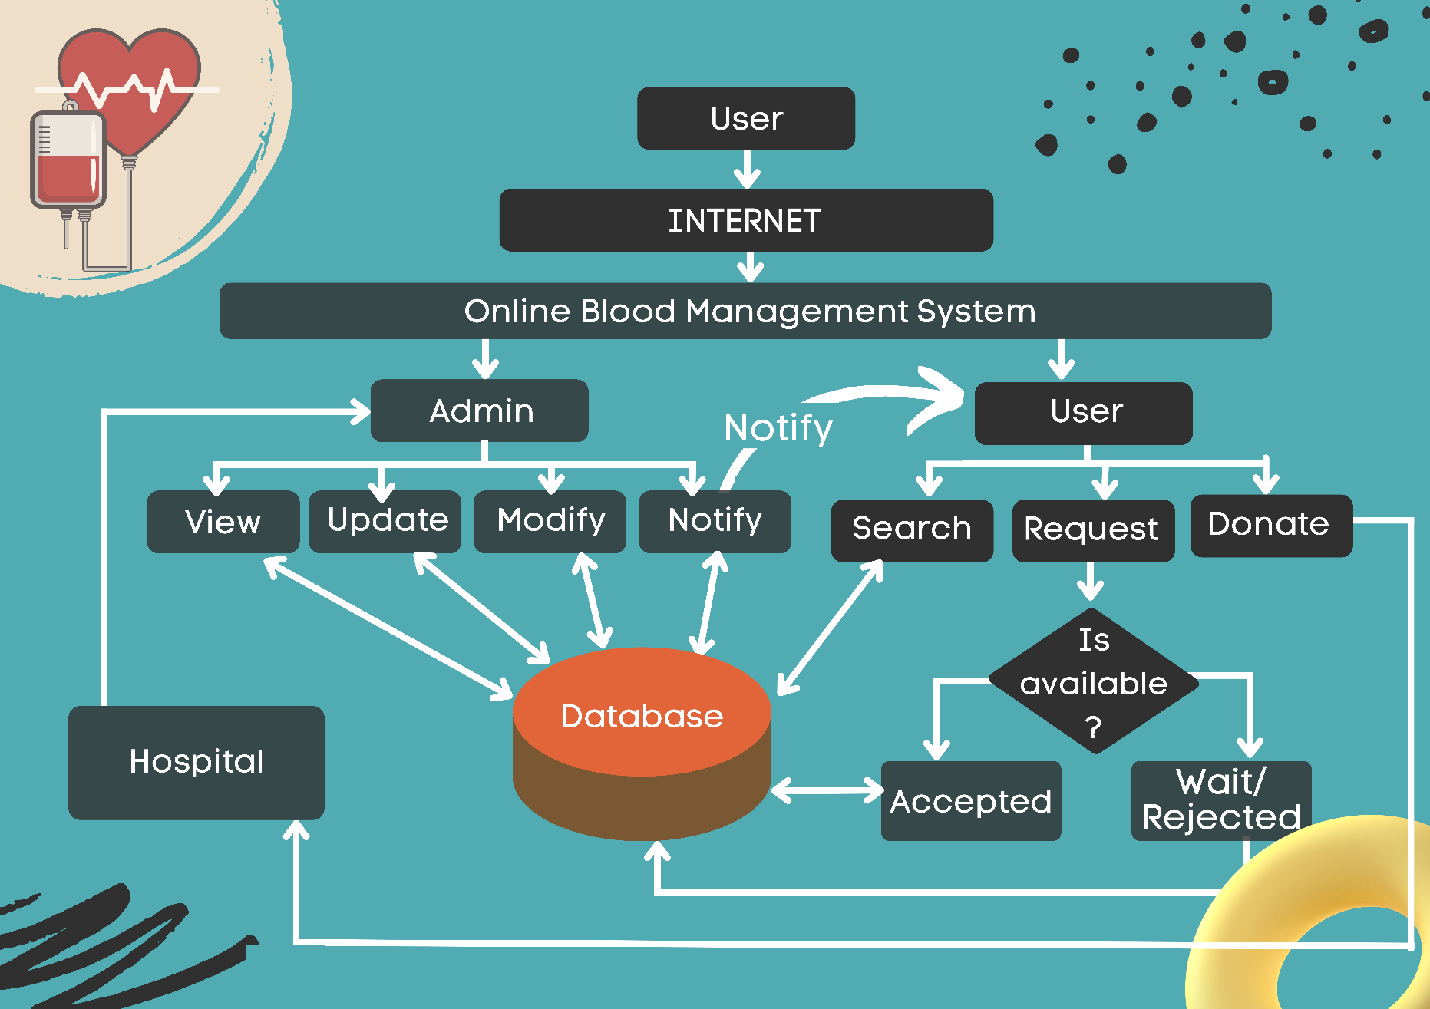
System Architecture

Slide 8
Advantages and Disadvantages
Advantages :
There are many benefits to blood donation website such as its convenience and social acceptability.
Blood Donation Website provides an easy intermediate to donate blood amongst new generation.
Management and Arrangement of the Blood Donation can be done with ease.
Disadvantages:
Our website is not capable of providing blood need alerts depending on type of blood group.

Slide 9
Applications
Our website can also be used in camps as it asks for data to understand eligibility for donation.
If during any checkup or treatment some infection or any such medical condition is detected then the concerned MP (medical practitioner) will update us and we will update our website accordingly.

Slide 10
Conclusion
Hope – Blood Donation Website provides an easy, secure and provide 24/7 availability of fast services, within just a click of a button you can save lives.

Slide 11
References
[1] Varnika Srivastava, “Blood Donation Crisis in India”,the logical Indian.
[2]Wojciech Zabierowski ,“Using Google Maps API for website development”,reserchgate.
[3] Sara A. Hashim, Afnan M. Al-Madani, Shatha M. Al-Amri, Abeer M. Al-Ghamdi, Bayan S. Bashamakh. Nahla Aljojo, PhD,“Blood donation management system ”, Life Science Journal 2014;11(8).
[4]Hisham S, Al-Madani A, Al-Amri A, Al-Ghamdi A, Bashamakh B, Aljojo N.,“Online Blood Donation Reservation And Managementsystem”, Life Sci J 2014;11(8):60-65]. (ISSN:1097-8135).

Slide 12


